Slide 1

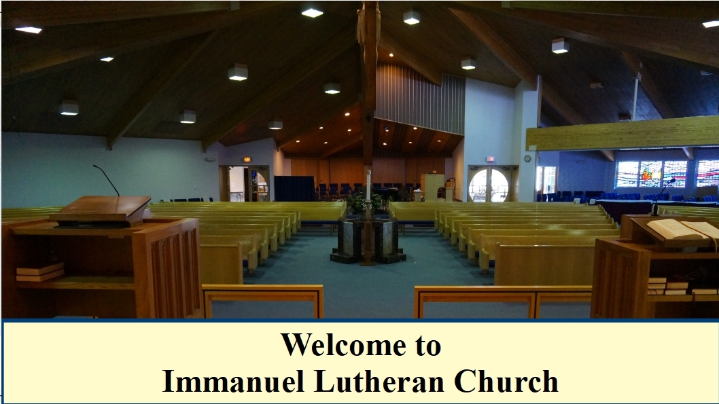

Slide 2
“COMMUNION ACCESSIBILITY”
A
N
N
O
U
N
C
E
M
E
N
T
We try to accommodate
everyone who worships with us at Immanuel.
If for any reason
you are ubable to commune at the altar,
please inform an usher,
and we will bring communion to you in your pew.

Slide 3

“HEARING ASSIST DEVICES”
A
N
N
O
U
N
C
E
M
E
N
T

Slide 4
B
I
B
L
E
S
T
U
D
Y
“FOLLOW”
Jesus only issues an invitation to relationship
That begins with a simple request: “Follow Me”.
SMP Pastor Al Kersten leads this DVD/workbook
based study by Andy Stanley, as we journey
to follow Jesus through the Gospels.
The class begins Sunday mornings at 9:15
in the adult education room.

Slide 5
B
I
B
L
E
S
T
U
D
Y
“ROOTED IN THE PREEMINENT CHRIST”
This study which is led by Pastor Erickson meets at 9:15 a.m.
in the church library – lounge.
St. Paul’s letter to the Colossians is used to guide the study and discussion.

Slide 6
B
I
B
L
E
S
T
U
D
Y
“BEING LUTHERAN”
A Youth / Adult Bible Class meets Sunday mornings at 9:15 A.M.
in the fellowship room.
This study is led by Pastor Schultz.
The class uses the book
written by Pastor Trevor Sutton of Haslett, MI.,
entitled “Being Lutheran”.

Slide 7
B
I
B
L
E
S
T
U
D
Y
“EARLY BIRD BIBLE STUDY”
This study meets Monday mornings
at 7:00 A.M. in the lighthouse room
of the Thunder Bay River Restaurant.
Pastor Erickson leads
this current study
is in the book of 1 Kings.

Slide 8
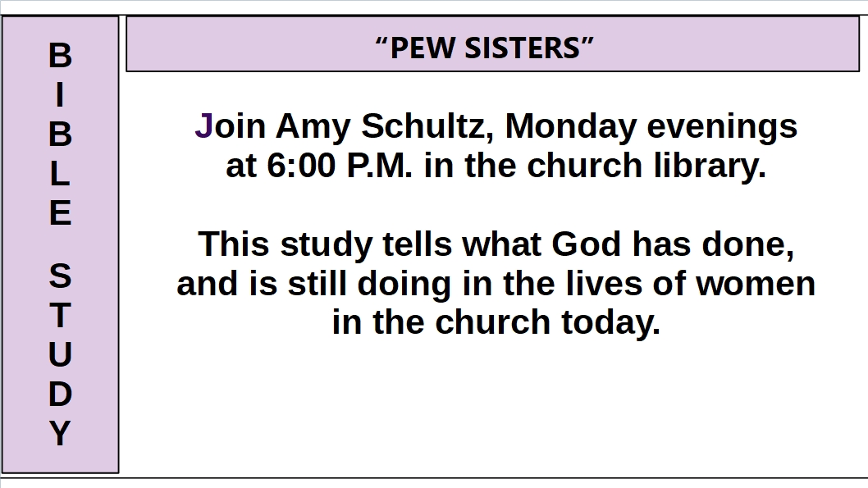

Slide 9
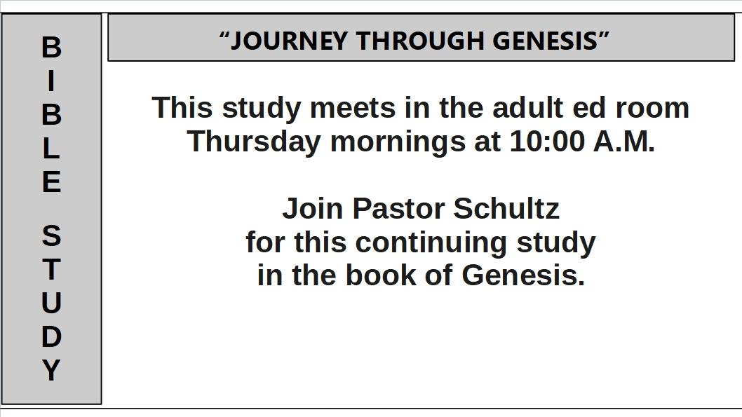

Slide 10
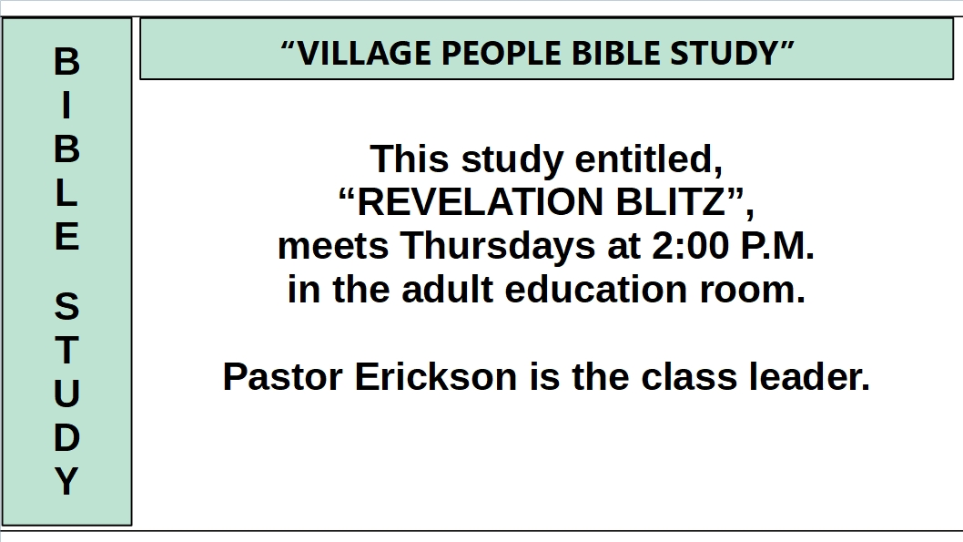

Slide 11
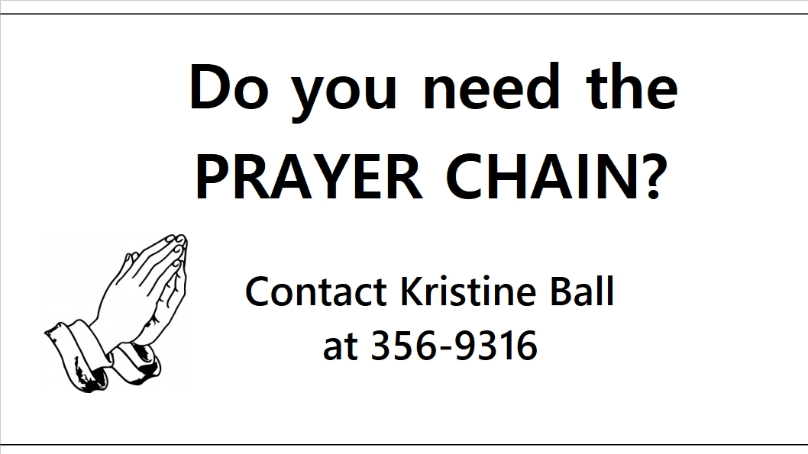
“PRAYER CHAIN INFO”
A
N
N
O
U
N
C
E
M
E
N
T

Slide 12
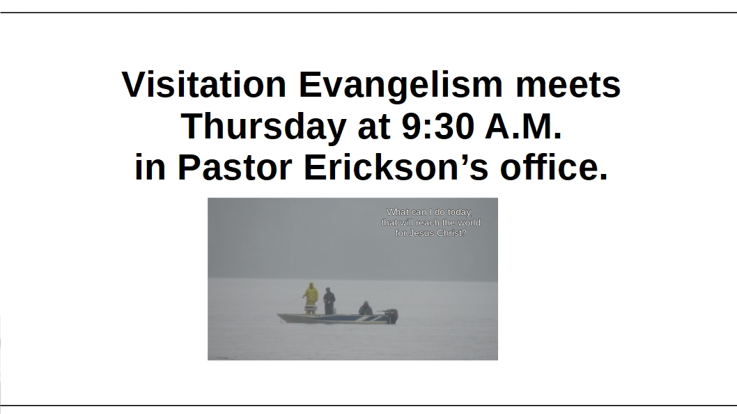
“VISITATION EVANGELISM”
A
N
N
O
U
N
C
E
M
E
N
T

Slide 13
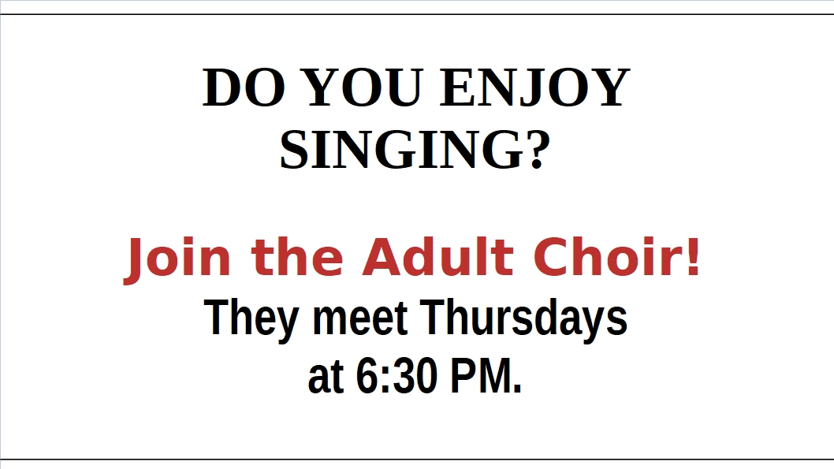
“ADULT CHOIR NEEDS YOU!”
A
N
N
O
U
N
C
E
M
E
N
T

Slide 14

“YOUTH GROUP MEETING”
A
N
N
O
U
N
C
E
M
E
N
T

Slide 15
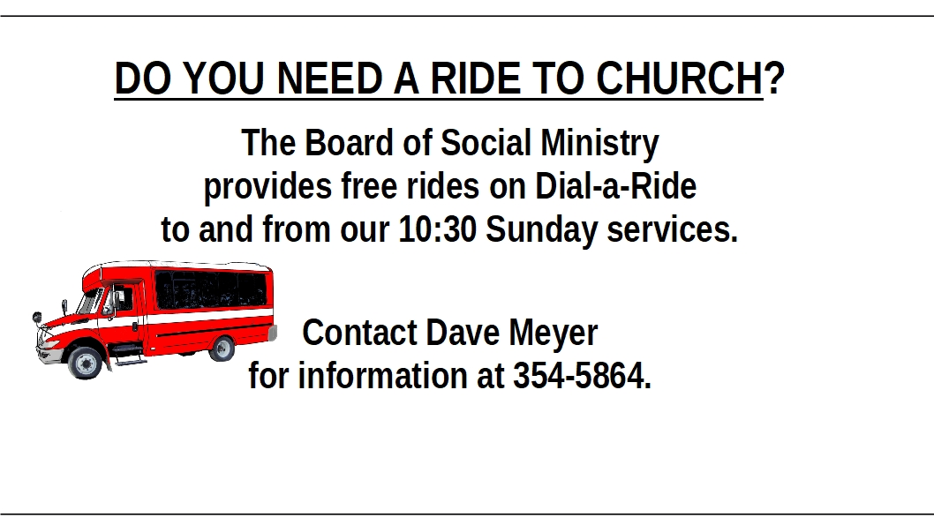
“FREE RIDE TO CHURCH”
A
N
N
O
U
N
C
E
M
E
N
T

Slide 16
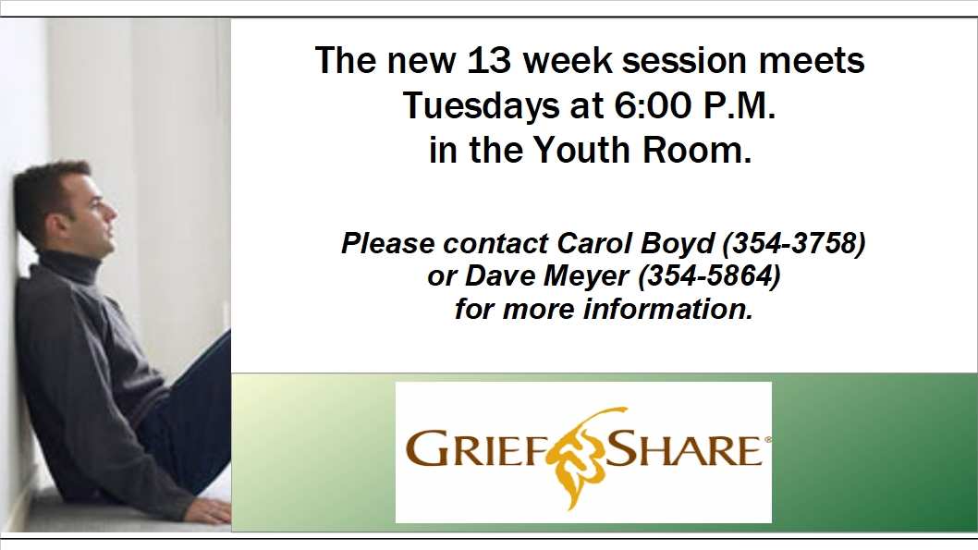
“HEARING ASSIST DEVICES”
A
N
N
O
U
N
C
E
M
E
N
T

